Slide 1
Employee Data Analysis using Excel
STUDENT NAME:GOMATHI.M
RREGISTERNO: 312204234
DEPARTMENT : B.COM ACCOUNTING AND FINANCE
COLLEGE: ANNAI VIOLET ARTS AND SCIENCE COLLEGE.

Slide 2
PROJECT TITLE
CREATING AN EMPLOYEE PERFORMANCE SCORECARD IN EXCEL.

Slide 3


AGENDA
Problem Statement
Project Overview
End Users
Our Solution and Proposition
Dataset Description
Modelling Approach
Results and Discussion
Conclusion
3/21/2024 Annual Review

Slide 4

PROBLEM STATEMENT
PROBLEM A company's customers have different needs, and the company must deliver on those needs.
EXPLANATION:
Customers want quality, while others want short lead times. The company needs to consider both internal business processes and customer satisfaction to deliver on these needs. SOLUTION: The company needs to continually innovate and improve its products and services to keep up with customer needs and competitors.

Slide 5

PROJECT OVERVIEW
A scorecard is a high-level snapshot of an organization's performance that displays key performance indicators (KPIs) and their targets.
A project scorecard is closely related to a project dashboard, which focuses on short-term goals, while a project scorecard focuses on long-term objectives.
.

Slide 6

WHO ARE THE END USERS?
The end users of a scorecard in Excel can be anyone who needs to see a high-level snapshot of performance, including: Managers: Can use scorecards to monitor and review employee performance. Organizational leaders: Can use scorecards to align resources and initiatives with strategic priorities. Other stakeholders: Can use scorecards to communicate strategy and performance across the organization.

Slide 7

OUR SOLUTION AND ITS VALUE PROPOSITION
It's made up of four perspectives, each with its own value
CUSTOMER PERSPECTIVE :
Focuses on customer value, satisfaction, and retention. It helps companies understand what their customers want and need, and how to offer products and services that meet those needs. FINANCIAL PERSPECTIVE: Focuses on increasing a company's revenue and profit. It helps companies manage risk and ensure they're earning a return on their investments.

Slide 8
Dataset Description
Title: Use a title to clearly describe the data. Header row: Include a header row that contains variable labels. Rows: Include rows that contain the data for each case. Columns: Include columns that contain the data for each variable. Labels: Optionally, include labels in the first column to provide a meaningful name or identifier for each case.
Time Frame Review Period: The time frame for the performance review (e.g., quarterly, annually)

Slide 9

THE "WOW" IN OUR SOLUTION
The "wow "in our solution is here are two :
KPI tracking Excel can be used to track KPIs, which can help businesses identify trends, patterns, and areas of improvement. PivotTables PivotTables are a useful tool for data analysis in Excel. They can summarize large data sets based on what the user wants to see.
3/21/2024 Annual Review
9

Slide 10
MODELLING Approach
Define Objectives Purpose: Determine the primary goals of the scorecard (e.g., performance evaluation, training needs assessment). Stakeholders: Identify who will use the scorecard and their specific requirements 2. Identify Key Performance Indicators (KPIs) Select Relevant KPIs: Choose KPIs that align with business goals, such as: Productivity (e.g., sales targets) Quality (e.g., error rates) Engagement (e.g., feedback scores)
10

Slide 11
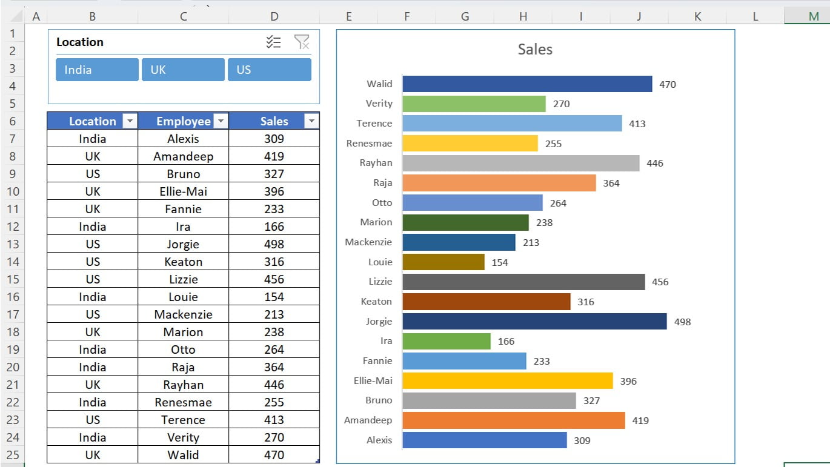
RESULTS
11

Slide 12
conclusion
Overall, a well-implemented employee performance scorecard in Excel not only enhances individual and team performance but also contributes to broader organizational success. It establishes a culture of accountability, continuous improvement, and strategic alignment with business goals.

